Slide 1
Event Handling

Slide 2
any program that uses a graphical user interface
Events are supported by a number of packages, including java.util, java.awt, and java.awt.event.
There are several types of events, including those generated by the mouse, the keyboard, and various GUI controls, such as a push button, scroll bar, or check box.

Slide 3
The Delegation Event Model
Defines standard and consistent mechanisms to generate and process events.
Concept:
a source generates an event and sends it to one or more listeners.
listener simply waits until it receives an event.
Once an event is received, the listener processes the event and then returns.

Slide 4
listeners must register with a source in order to receive an event notification.
notifications are sent only to listeners that want to receive them.
more efficient way to handle events
Advantage
Application logic that processes events is cleanly separated from the user interface logic that generates those events.

Slide 5
Events
In the delegation model, an event is an object that describes a state change in a source.
an event can be generated as a consequence of a person interacting with the elements in a graphical user interface.
may also occur that are not directly caused by interactions with a user interface.

Slide 6
Event Sources
A source is an object that generates an event.
This occurs when the internal state of that object changes in some way.
Sources may generate more than one type of event.
A source must register listeners---for the listeners to receive notifications about a specific type of event.

Slide 7
Each type of event has its own registration method.
general form:
public void addTypeListener (TypeListener el )
Type : name of the event,
el :reference to the event listener
Eg:
method that registers a keyboard event listener - -- addKeyListener( ).
The method that registers a mouse motion listener - addMouseMotionListener( ).

Slide 8
When an event occurs, all registered listeners are notified and receive a copy of the event object.
known as multicasting the event
Some sources may allow only one listener to register-- known as unicasting the event.
general form:
public void addTypeListener(TypeListener el )throws java.util.TooManyListenersException

Slide 9
A source provide a method that allows a listener to unregister an interest in a specific type of event.
general form:
public void removeTypeListener(TypeListener el )
Eg:
to remove a keyboard listener- removeKeyListener( ).
The methods that add or remove listeners are provided by the source that generates events.
Eg:
Component class provides methods to add and remove keyboard and mouse event listeners.

Slide 10
Event Listeners
listener is an object that is notified when an event occurs.
two major requirements.
it must have been registered with one or more sources
it must implement methods to receive and process these notifications.
The methods that receive and process events are defined in a set of interfaces, such as those found in java.awt.event.

Slide 11
Event Classes
The classes that represent events are at the core of Java’s event handling mechanism.
root of the Java event class hierarchy is EventObject, which is in java.util.
It is the superclass for all events.
Its one constructor is:
EventObject(Object src)
src is the object that generates this event.

Slide 12
EventObject defines two methods:
getSource( ): returns the source of the event.
Object getSource( )
toString( ): returns the string equivalent of the event
class AWTEvent
subclass of EventObject.
defined within the java.awt package
the superclass (either directly or indirectly) of all AWT-based events used by the delegation event model.

Slide 13
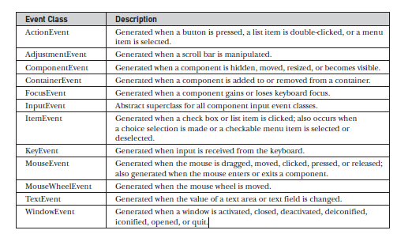

Slide 14
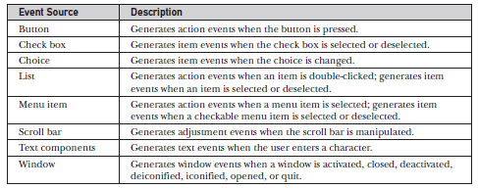
Sources of Events

Slide 15
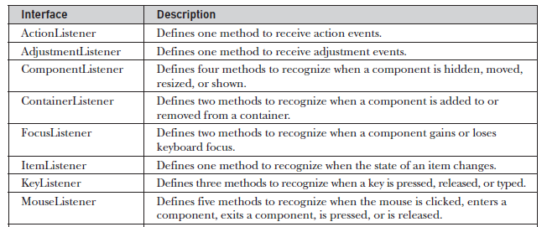
Event Listener Interfaces

Slide 16
